Slide 1

DEEP LEARNING FOR BONE AGE PREDICTION FROM WRIST X-RAYS

Slide 2
CONTENTS
Why Bone Age prediction
Bone Diagram
Dataset
Data Augmentation
Model Architecture
Results
Future work

Slide 3
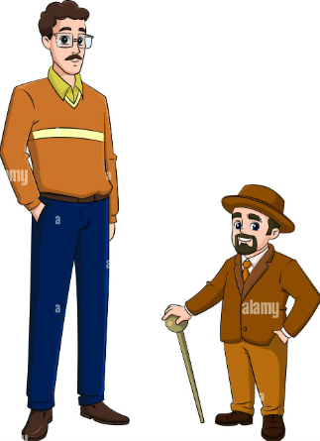


WHY BONE AGE PREDICTION IS NECESSARY ?
1
2
Impaired or accelerated growth
Orthopaedic Treatment Planning
3
Chronic diseases affecting growth and development, such as endocrine disorders or kidney disease

Slide 4
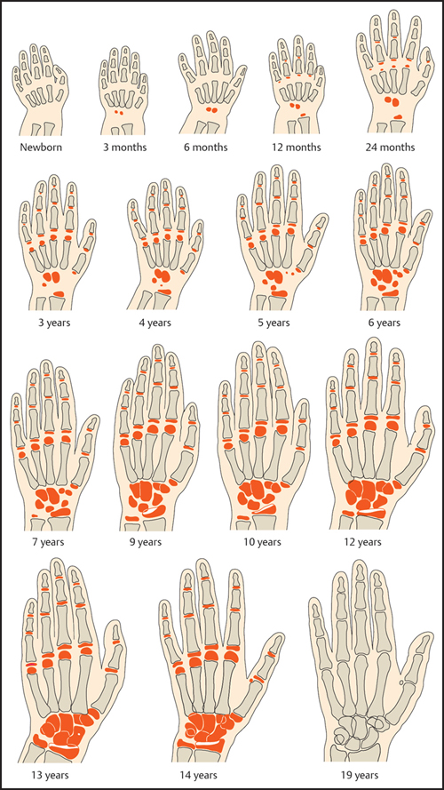
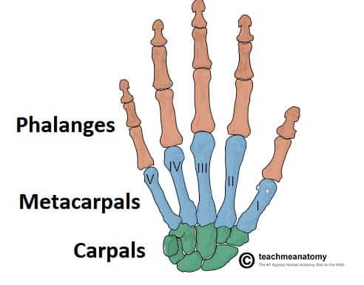
SKELETAL DEVELOPMENT IN THE HAND
Bone age is based on this developmental pattern
Specific ossification centres in different age groups

Slide 5
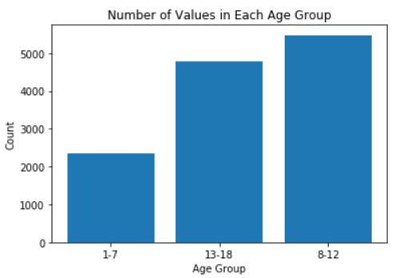
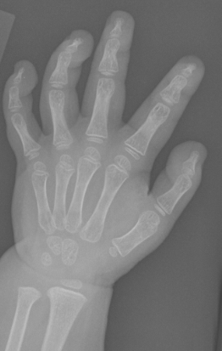
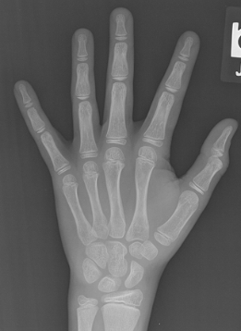
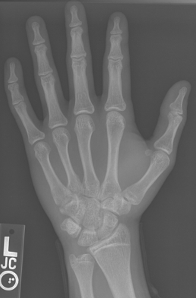
DATASET
RSNA Dataset: 14,236 hand X-rays (12 611 training set, 1425 validation set, 200 test set).
5,778 female subjects and 6,833 male subjects
Age range of 1–228 months.
5475
4791
2345
1-7 Years
8-12 Years
13-18 Years

Slide 6
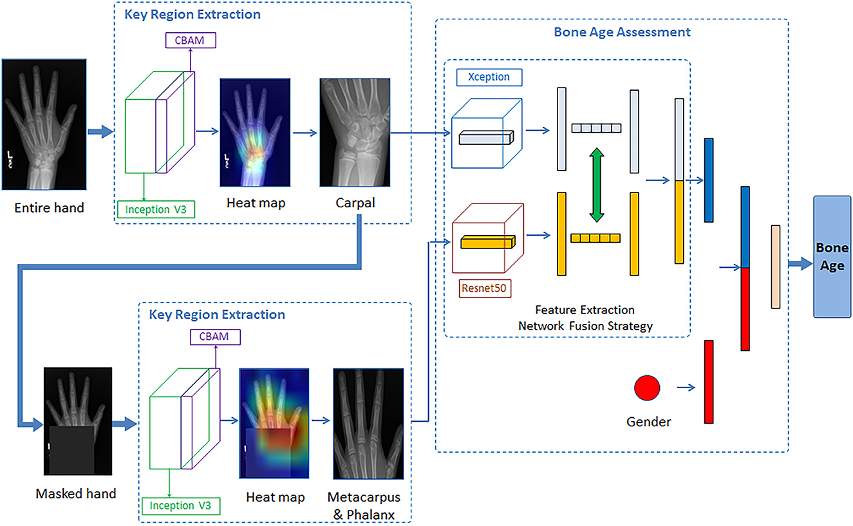
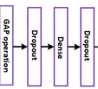
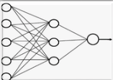

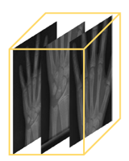
MODEL ARCHITECTURE
Data Augmentation Techniques:
1. Horizontal Flipping 2. Vertical Flipping 3. Rotation
4. Shifting 5. Zooming 6. Normalization
7. Shear Range, Height 8. Width Shift Range
Feature Extraction and Training
Regression Network
Bone Age
Xception (base model)
Data Augmentation
Bone Age
Inception ResNetV2 (base model)
Bone Age
MobileNet (base model)
Custom Top head

Slide 7
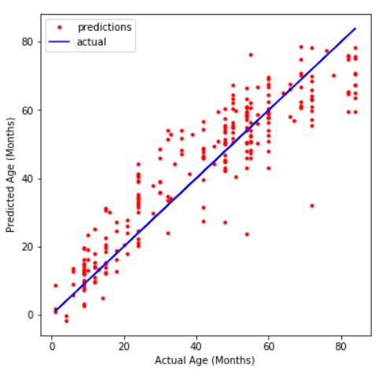
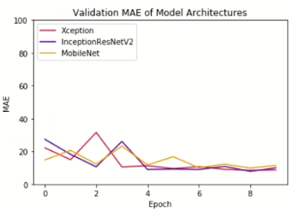
RESULTS
MAE (months) | 1-7 Years | 8-12 Years | 13-18 Years
XCEPTION | 7.972 | 11.706 | 10.960
INCEPTION-RESNETV2 | 7.386 | 11.160 | 9.009
MOBILE NET | 8.796 | 13.306 | 11.257
Average | 8.051 | 12.057 | 10.409
Inception-ResnetV2 Graph
Comparison of Models for 1-7 years
Class I: 1-7 Years

Slide 8
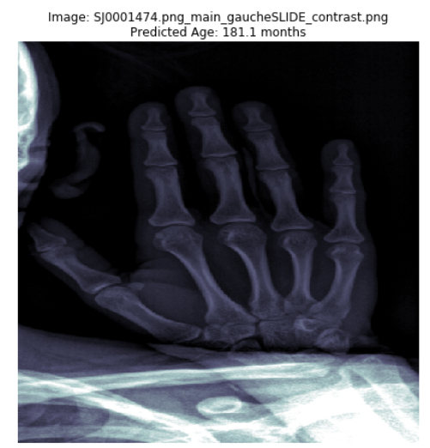
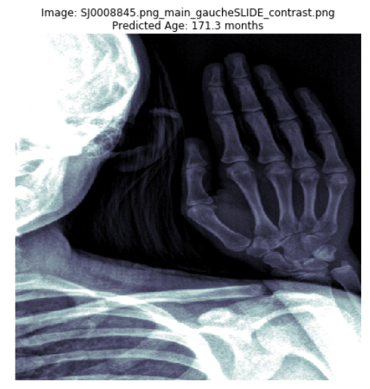
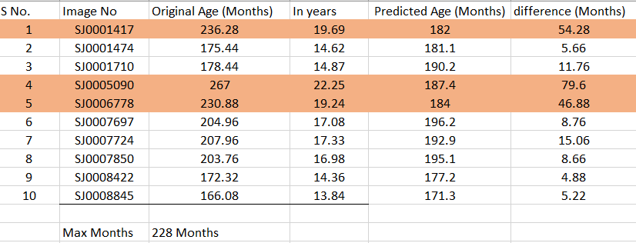
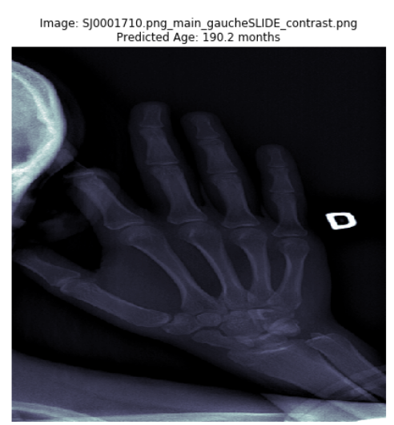
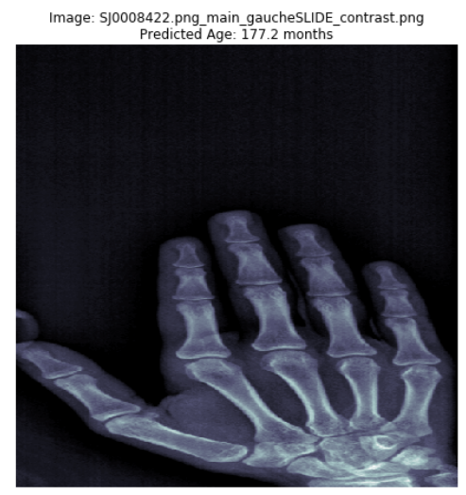
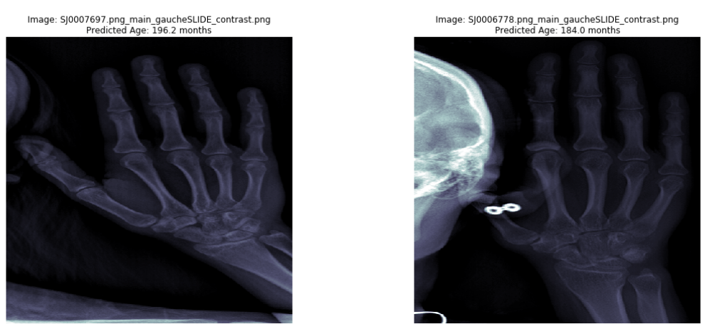
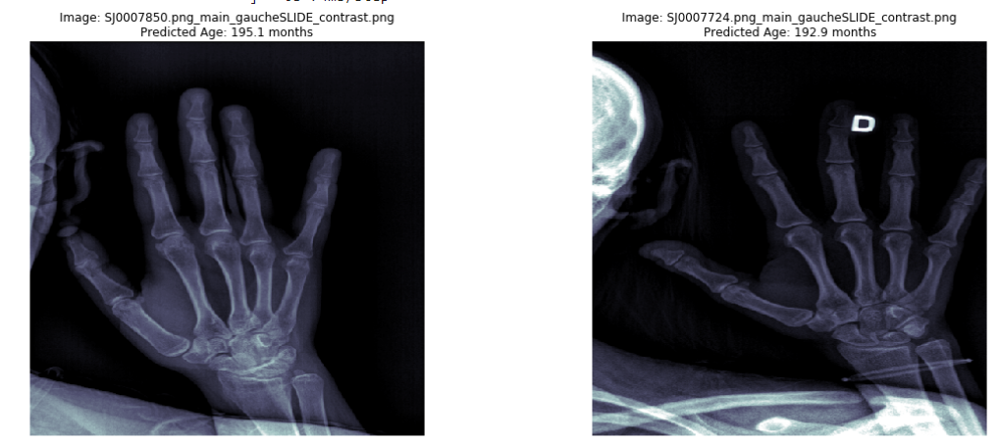
RESULTS

Slide 9

FUTURE WORK
Ensemble Models
Heat Maps
Clinical Integration

Slide 10



